Slide 1



Win/Loss Prediction in Major League Soccer using Deep Learning model
Team-11:
['Ben Reed',
'Daniel Gonzalez',
'M A Moonem',
'Sean Tyson']
August, 2021
Notes:
Moonem:
Good evening everyone!
Since, this is officially the last class, on behalf of our team (BEN, Daniel, myself and Sean) and all my classmates, I would like to express our heartfelt thanks and gratitude to our Instructor Teddy, who has been a passionate and dedicated instructor from the beginning of this course.
I must appreciate his instruction style – always smiling, optimistic and encouraging.
I would like to thank - Artem, Geoff, Gael, David, Sara, Ritesh and all other TAs for their friendly support.
Special thanks to Nick Barranco, UT Austin, Trilogy and people behind this amazing Boot Camp who created this outstanding content for the Modules.
[40 sec]
Now Sean will introduce you with the topic in detail.

Slide 2
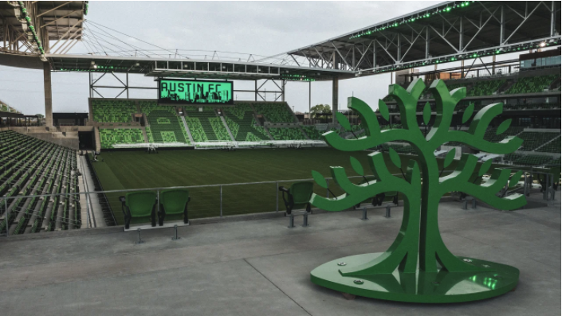
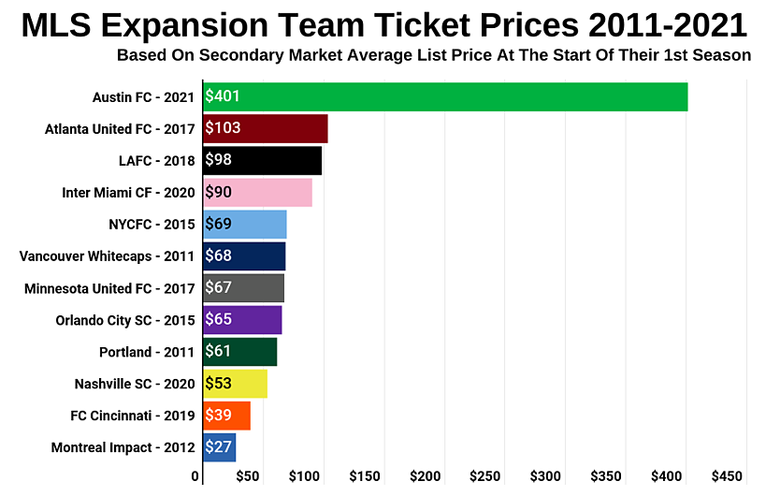
Topic
Win/Loss Predictions in Major League Soccer using a Deep Learning model
Purpose:
Austin is now home to a brand new MLS expansion team, Austin FC
We plan to attend a game, but ticket prices are through the roof
In order to strategically select our tickets, we wanted to dig into the historic performance of rival clubs and develop a machine learning model to predict match outcomes for our home team's first season
Notes:
Sean:
Thank you Moonem
The project we chose incorporates three things near and dear to the hearts of our team: Sports, Austin, and data.
As many of you probably know, Austin in now home to a new MLS expansion team, Austin FC.
And not only do we have a new local team to cheer for, we also have an incredible new venue, Q2 stadium, located off Braker and Burnett
As excited as we are about these new developments, Unfortunately, the team is off to a rocky start, with a record of 4 wins, 4 draws, and 9 losses so far this season.
Additionally, ticket prices are sky high, as you can see in this chart here of expansion team ticket prices.
Our team is eager to attend a game in the beautiful new stadium, but if we are going to spend that much money, we’d love to attend a game where the home team wins.
So, we decided to develop a machine learning model to predict match outcomes for our home team’s first season, and also build a dashboard that analyzes the historic performance of rival clubs to further help us select an upcoming match that Austin FC might win.
I’ll now hand it over to Daniel to discuss our data.
Source: https://blog.ticketiq.com/blog/how-to-find-the-cheapest-austin-fc-tickets-all-face-value-options

Slide 3

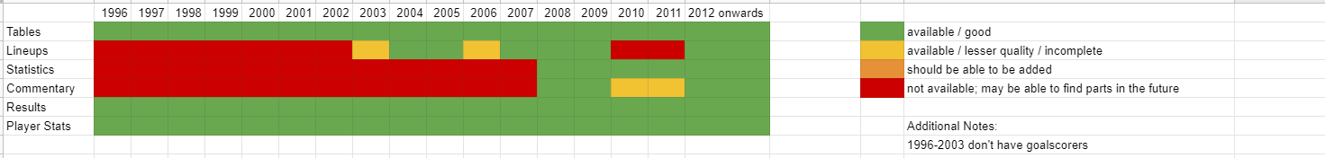
Data Source
Kaggle data,
Major League Soccer Dataset - by Joseph Mohr, last updated 11th July, 2021; version 34. The weblink: https://www.kaggle.com/josephvm/major-league-soccer-dataset
Contains player, game, event, goalkeeper, and table data on Major League Soccer (MLS)
Data from 1996-2021
Covers over 6000 matches, almost 420,000 events.
Data Quality:
Rated 8.8 for Data Usability.
We used from 2008 to 2021 because of mostly null data before then.
Notes:
Ben
We got our data from Kaggle
Where we’ve got four dataset in .csv format.
These are data from 1996-2021 on over 6000 matches.
As we see from the figure below, we could use data from 2008 onward because of plenty of null values in previous data.

Slide 4

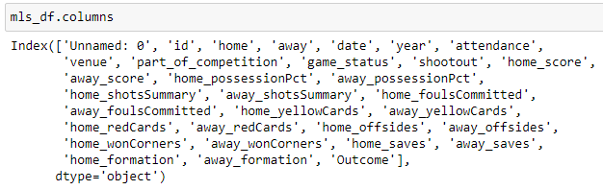
Finding answers from the data
The following figure shows the column headers which are essentially the input FEATURES (X) and the last “outcome” column is the OUTCOME (y) for the Machine Learning Model.
As the headers say, we expect to relate a good prediction of outcome based on the feature columns.
Notes:
Ben:
If we look at the column headers, we see the selected KEY features are there,
Although we used only a few columns as FEATURES that can be known before a match starts

Slide 5

Data Exploration
Steps:
Each member worked on one .csv file to understand the data content
Understand abbreviated column headers.
Determine insignificant data that may be dropped.
Identify columns with data anomalies which needed to be cleaned.
Since we’re predicting game outcomes for our home team Austin FC, and Austin FC has only data from 2020 onward, we decided to drop most of the “home-” related columns to make the prediction more meaningful.
We decided to use only data points that can be known prior to the start of the match, (e.g., home & away teams, venue, day of the week, and the average previous-year performance of the away team (calculated).
Notes:
Ben:
In this stage, we all individually worked on separate data files, for example, dataset on players, matches, goalkeepers, events etc.
Identified the scope of data cleaning and further analysis.

Slide 6

Data Analysis
Data Exploration - datatype, columns, deciding on NULL values
Data Cleaning:
Updated column titles for clarity
Removed all data prior to 2004 (due to most of the columns having null values)
Removed seemingly insignificant data column
Renamed mismatching club names, venue names
Removed duplicate entries, e.g., venue names, team names
Applied regex on a date column with anomaly in entry
Created functions to fill in NULL values
Created Database - ERD with matches, players, goalkeepers and tables data
Exported the cleaned .csv files to the project folder and major_league_soccer db
Imported / read clean files from DB for ML processing phases
Neural Network model:
Preprocessing: Binning/bucketing of categorical variables > OneHotEncoding > StandardScaler
Defining NN model > Compile > Train > Evaluate.
Notes:
Daniel:
This slide is the brief summary of what we did with the data in this project.
From exploration > cleaning > creating database > and finally processing data for the Neural Network Model.

Slide 7
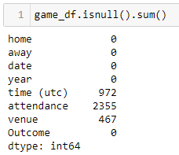
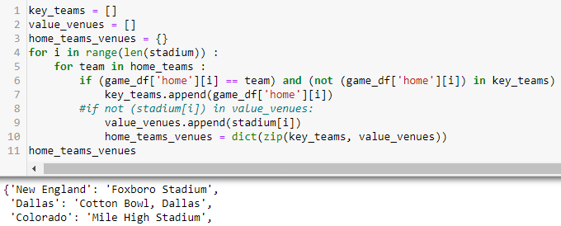
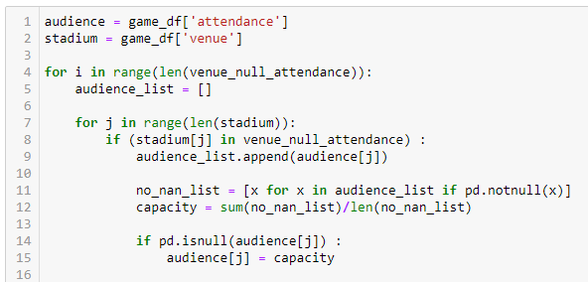
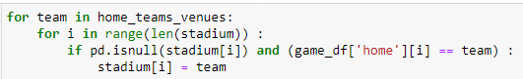

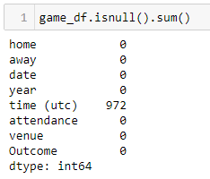
Data
Cleaning
BEFORE:
Created a dictionary by mapping home team to home venue to fill NULL “venue” as follows,
Filled in NULL ‘attendance’ using code-block as follows,
AFTER:
Notes:
Daniel:
Data cleaning was the most time-consuming in this project, as we’ve got dataset with plenty of NULL values.
The snapshot of codes and functions show how we cleaned up TWO KEY COLUMNS to fill in the NULL row entries.

Slide 8

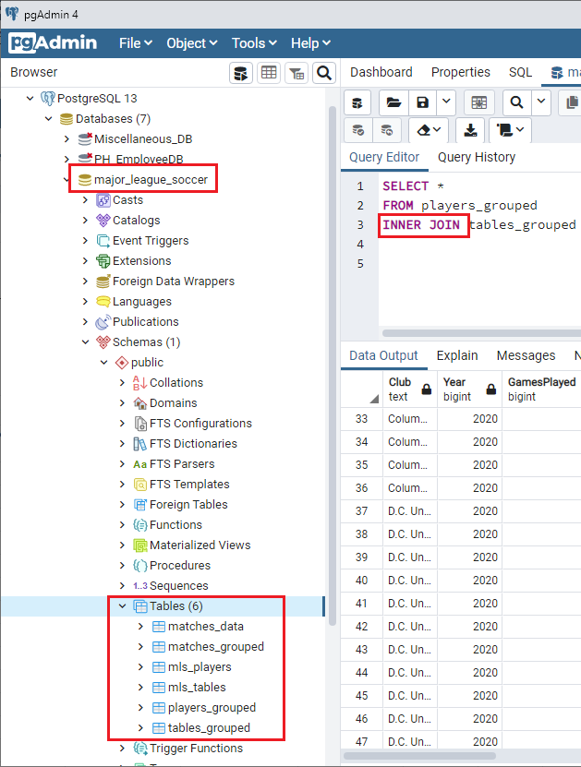
Database in PostgreSQL
Created a database “major_league_soccer” in PgAdmin
Exported 6 cleaned DataFrames to SQL tables
2 tables are joined using SQL Query
Imported data from SQL Database for ML Preprocessing
Notes:
Daniel:
Created DB > Stored clean datasets into DB > imported data from DB for ML processing.

Slide 9









Technologies Used
Notes:
Daniel

Slide 10

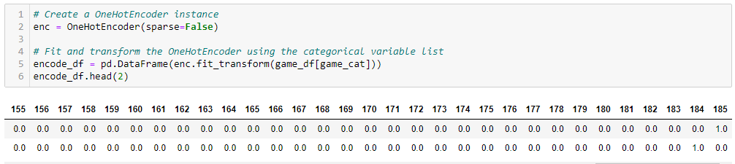

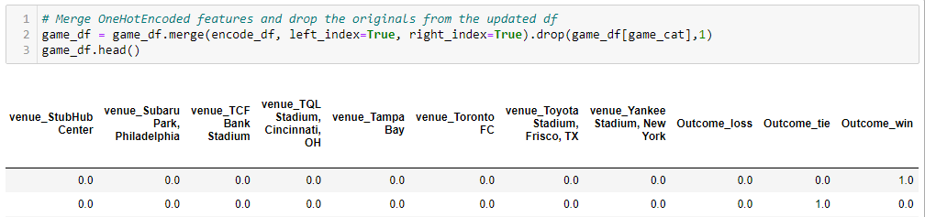

Why a Deep Learning Model?
We labeled historic data for our supervised learning algorithm (e.g., SVM, NN, Random Forest, etc.)
Neural Networks provide better accuracy and are able to better handle non-linear relationships.
Data Preprocessing:
Merging encode_df with original game_df:
Notes:
Moonem:
Since we worked with labeled data we chose Neural Network based Deep Learning as a supervised learning tool.
We did some preprocessing on cleaned data – encoded categorical variables like “venues”, “teams”
The encoded data then merged with the original dataframe.

Slide 11

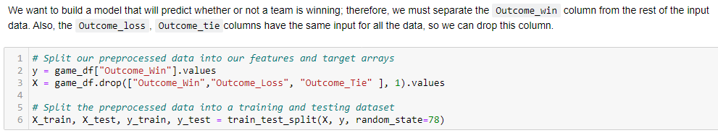
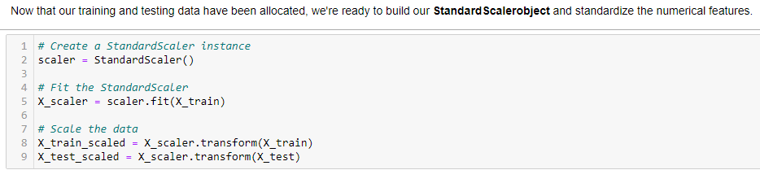

Deep Learning Model (continued)
Define features and output:
Standardizing training and testing dataset:
Notes:
Moonem:
Then we defined the features or X-values and y as “outcome Win”
In the Next step we used StandardScaler instance to standardize our test and training data

Slide 12
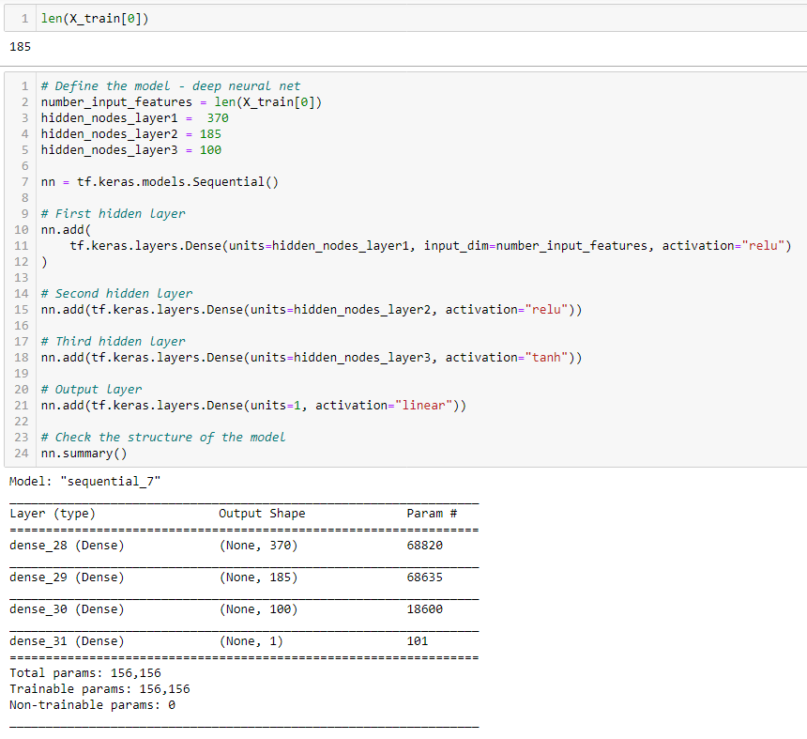
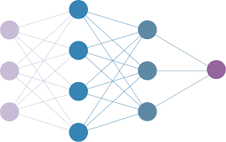
Deep Learning Model (continued)
Define neural network:
Notes:
Moonem:
Here we defined the NN model.
We chose 3 hidden layers, with input layer having 185 features, next layer is double of that and then reduced no. of neurons gradually.
We tried a few activation functions and found that ‘relu’ is better in hidden layers
And sigmoid is the right choice for binary classification.

Slide 13

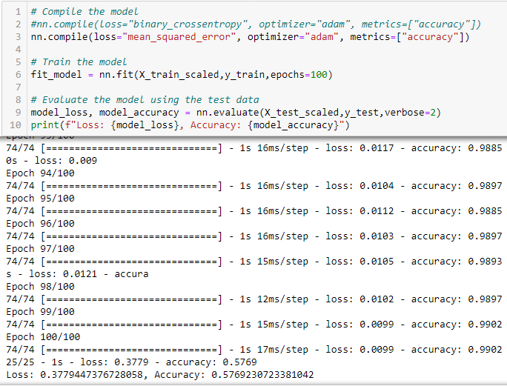
Deep Learning Model (continued)
Compile and Evaluate the neural network model:
Findings:
Our win-prediction accuracy is 58%.
Observation:
The accuracy of the model seems “fair enough.”
We’ve checked back, cleaned more data, optimized parameters and accuracy improved from 53% to 58%.
Notes:
Moonem:
We compiled – fit the model – and tested the model with test data and we found that
58% isn’t bad for an event that has 3 potential outcomes. Win, tie, loss
Sean will be presenting the Dashboard.

Slide 14
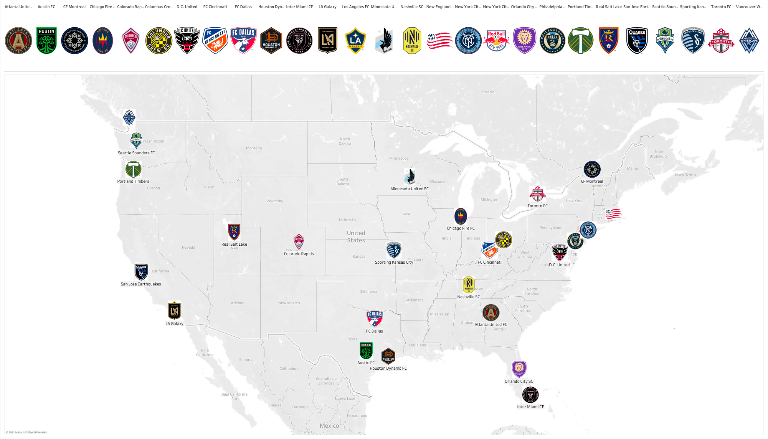
Major League Soccer Dashboard
Notes:
Sean: (command click to filter on multiple teams)
In addition to our deep learning model, we also built a dashboard in Tableau to review the historic performance of various MLS teams.
Logo (documents/my tableau repository/shapes/ create a newfolder
Then select from shape palettes and assign the logos to the various data items
Last 3 home games:
Seattle - 7/22 (L 0:1)
Colorado - 7/31 (L 0:1)
Houston - 8/4 (W 3:2)
Austin FC’s next 3 home games:
Vancouver - 8/18 YES
Portland - 8/21
Dallas FC - 8/29
LA FC - 9/15
San Jose - 9/18 YES

Slide 15
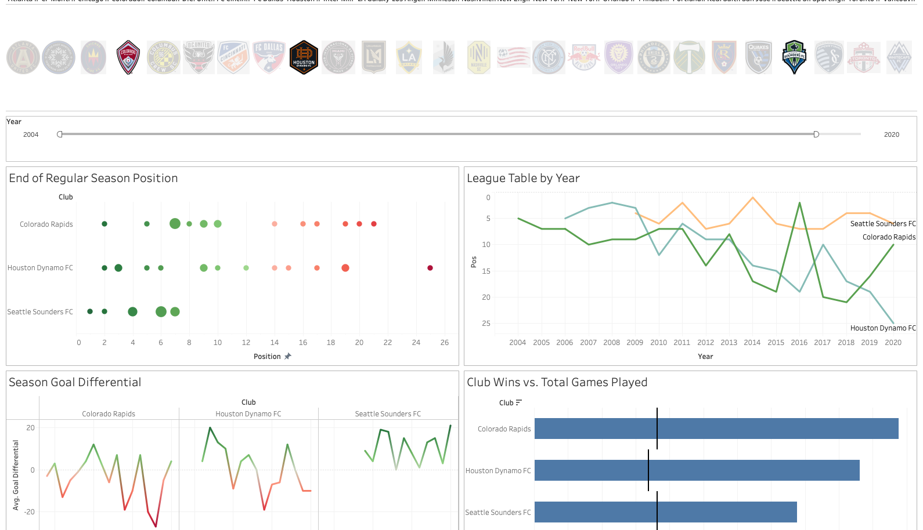
Major League Soccer Dashboard
Link:
“MLS Dashboard”
Showing:
Data on Austin FC’s three previous home opponents
Notes:
Sean:
Last 3 home games:
Seattle - 7/22 (L 0:1)
Colorado - 7/31 (L 0:1)
Houston - 8/4 (W 3:2)

Slide 16
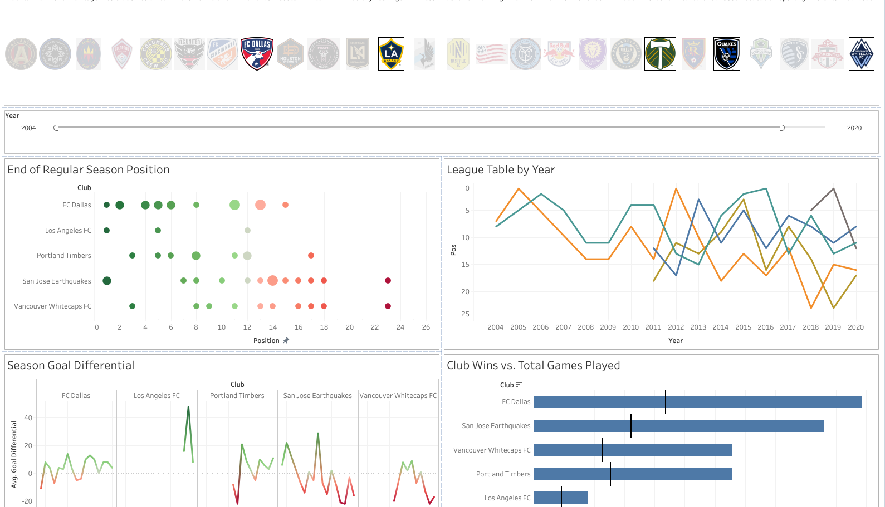
Major League Soccer Dashboard
Link:
“MLS Dashboard”
Showing:
Data on Austin FC’s next five home opponents
Notes:
Sean:
Austin FC’s next 5 home games:
Vancouver - 8/18 YES
Portland - 8/21
Dallas FC - 8/29
LA FC - 9/15
San Jose - 9/18 YES

Slide 17
Questions?
Thank You
Notes:
Sean:

